Slide 1
Java Programming
Basics

Slide 2
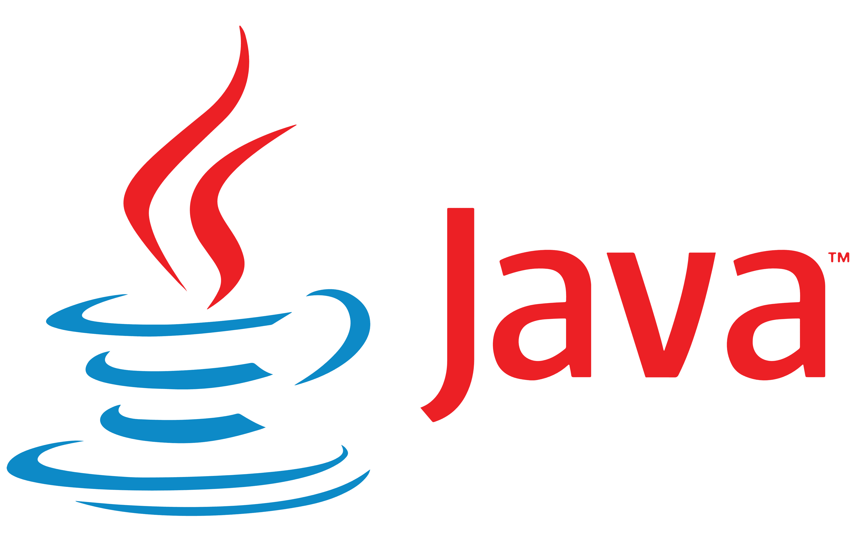
What is Java?
Java is a high-level, object-oriented programming language.
Popular for: Android apps, web applications, enterprise systems.
Fun Fact: Java’s motto is "Write Once, Run Anywhere".
Java was originally called Oak.

Slide 3
Why Learn Java in 2025?
✅ Still one of the most used languages in the world (used by millions of developers).
📱 Used to build Android apps, which dominate the mobile market.
🏢 Preferred by big companies for enterprise software (e.g., banks, insurance, e-commerce).
🌐 Runs on any platform – “Write Once, Run Anywhere” (Windows, Mac, Linux).
💼 High demand for Java developers in job markets across the globe.

Slide 4
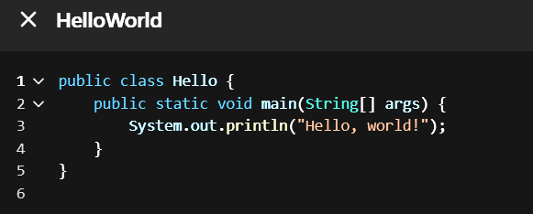
Java Syntax
Every coder starts from ‘Hello, World!’ — so keep practicing and stay curious.
Syntax = set of rules to write Java code.
Every Java Program must have a main() method
Example:
Real-life analogy: Like grammar in English – syntax ensures code is understood by the computer.

Slide 5
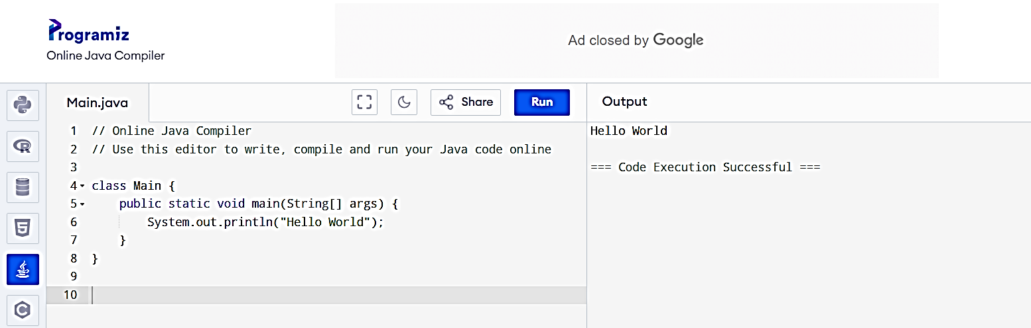
Where to Practice?
✅ Online IDE – no setup needed
👨‍🏫 Great for beginners and teachers
🧪 You can run and share Java code instantly
💡 Perfect for classroom-style learning

Slide 6
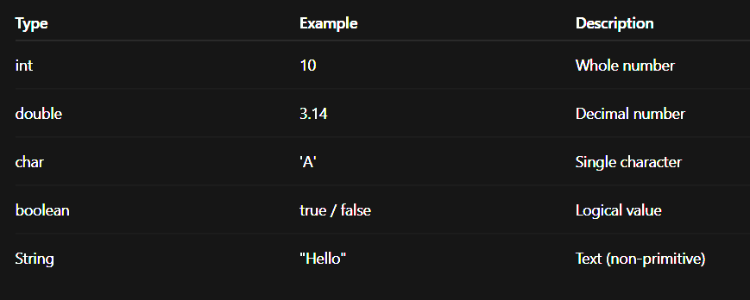
Data Types
Two types:
Primitive (int, float, char, boolean)
Non-primitive (String, Arrays, Objects)

Slide 7
Primitive Data Types (Simple Data) | Non-Primitive Data Types (Complex Data)
These are the basic building blocks in Java. | These are more advanced types created using classes.
They store simple values like numbers, letters, or true/false. | They store multiple values or complex information.
They do not have any functions or features. | They can do things using built-in methods/functions.
You can think of them like plain boxes holding values. | You can think of them like smart containers with tools inside.
int → for whole numbers (int age = 20;) | String → for text (String name = "Amit";)

Slide 8
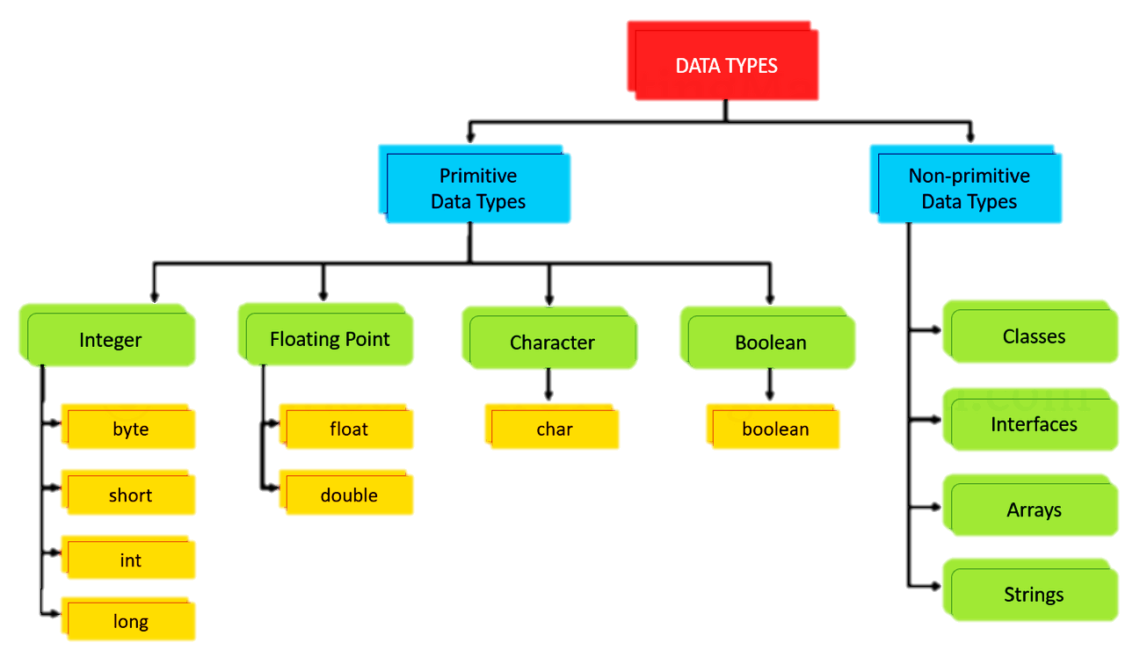

Slide 9
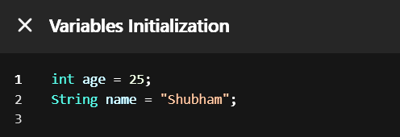
Variables
Variables store data.
Think of variables like boxes to store values.
Example:

Slide 10
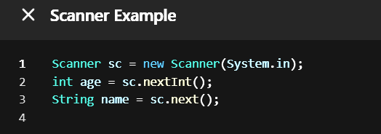
Scanner – Input from User
To take input from the user, we use Scanner.
Import first: import java.util.Scanner;

Slide 11
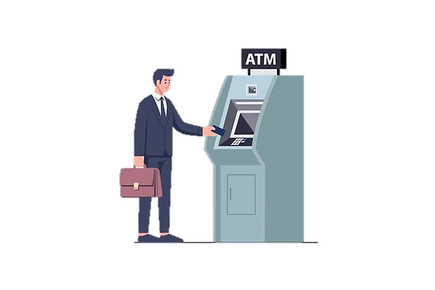
Real-Life Example of Input
Example: ATM machine
Asks for PIN (Input)
Shows Balance (Output)
You → Type PIN → System uses Scanner to read it.

Slide 12
Operators in Java
Arithmetic Operators
Relational (Comparison) Operators
Logical Operators
Assignment Operators
Unary Operators
Ternary Operator
Bitwise Operators (Advanced)

Slide 13
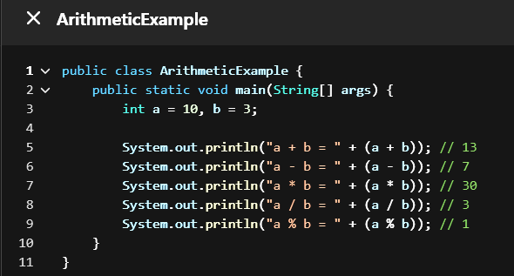
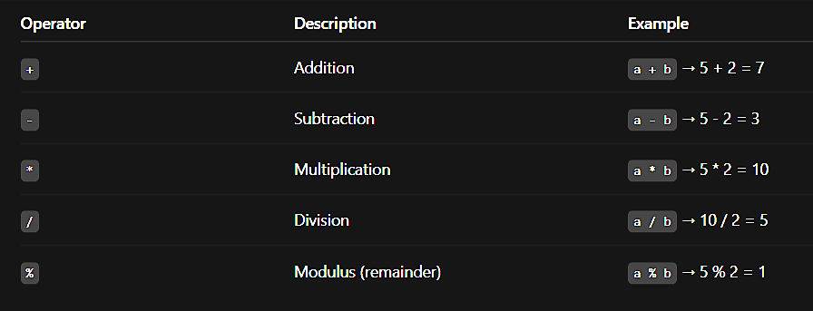
Arithmetic Operators

Slide 14
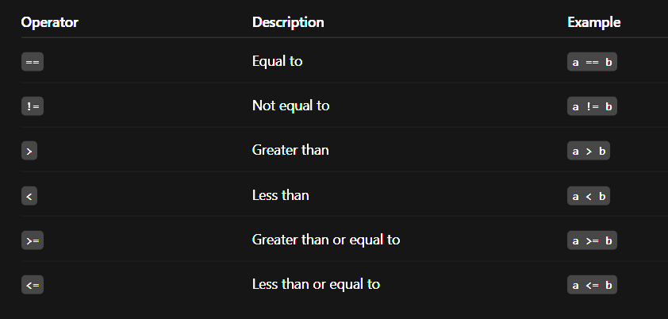
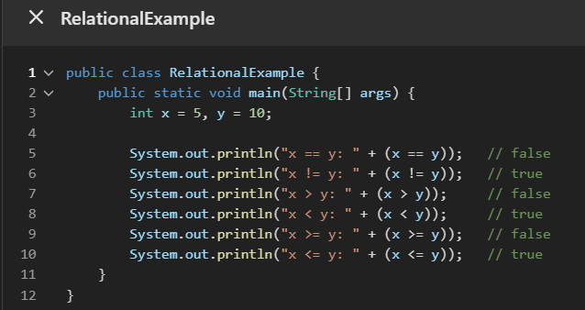
Relational (Comparison) Operators

Slide 15
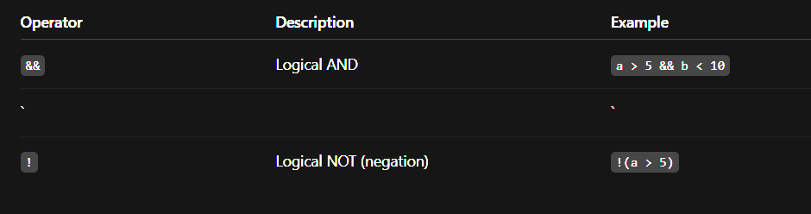
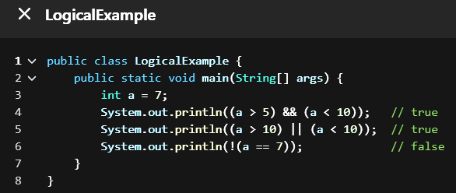
Logical Operators

Slide 16
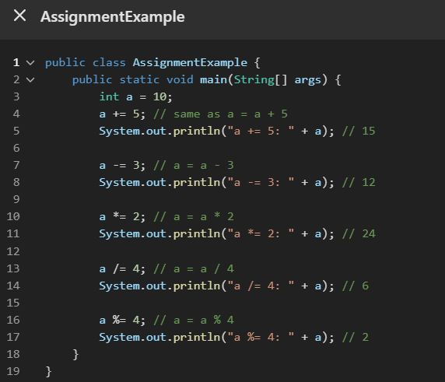
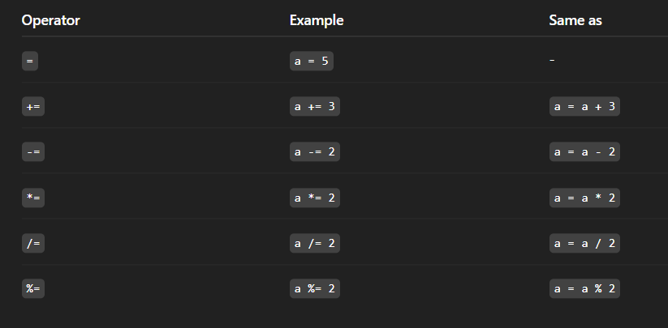
Assignment Operators

Slide 17

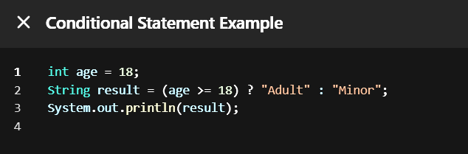
Ternary Operator
Explanation:
age >= 18 → this is the condition.
"Adult" → returned if the condition is true.
"Minor" → returned if the condition is false.

Slide 18
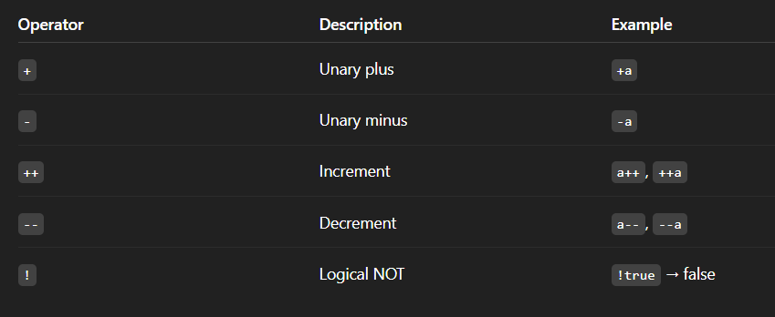
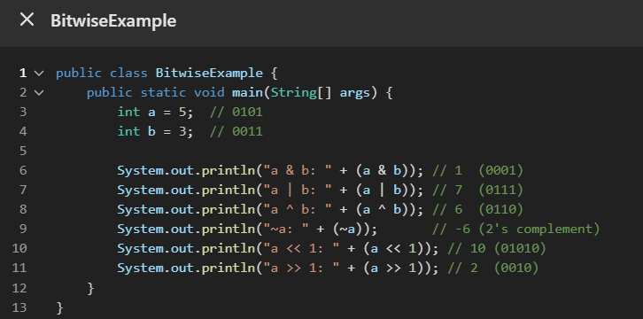
Unary Operators

Slide 19
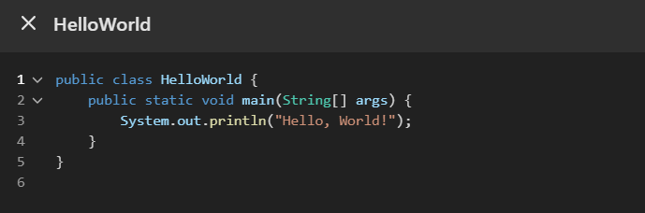
Java Code
public → This means anyone can access this class. It’s open to be used from anywhere.
class → This is a blueprint or template for the program. Every Java program must be inside a class.
HelloWorld → This is the name of the class. You can give any name, but it should match the file name

Slide 20
Java Code
public static void main(String[] args) {
public → Again means anyone can run this method.
static → This means it belongs to the class, not to an object. Java runs this method without creating any object.
void → This means the method does not return anything (no result comes back).
main → This is the name of the method that Java looks for to start running the program.
String[] args → This is used to take input from the user when running from the command line. Right now, we’re not using it, but it’s needed as part of the syntax.

Slide 21
Java Code
System.out.println("Hello, World!")
System → A built-in class in Java that has useful stuff like input/output.
out → Refers to the output stream (like your screen).
println → Means "print the line" — it will show the text and move to the next line.
"Hello, World!" → This is the text that gets printed.

Slide 22
What is a Keyword in Java?
A keyword in Java is a special word that Java already understands and has a fixed meaning.
You cannot use these words as names for your classes, variables, or methods because they are reserved.
Words in English like "if", "while", or "return" — Java knows what they mean and uses them to perform specific actions.

Slide 23
What is a Keyword in Java?
Simple Example: int age = 25;
int is a keyword → It tells Java: “This is a number type.”
You cannot name a variable as int, because it's already taken.
You can’t use keywords as variable or method names.
int return = 5; // ❌ Error: 'return' is a keyword

Slide 24
What is a Keyword in Java?
Keywords | Keywords | Keywords | Keywords
abstract | assert | boolean | break
byte | case | catch | char
class | const* | continue | default
do | double | else | enum
extends | final | finally | float
for | goto* | if | implements
import | instanceof | int | interface
long | native | new | package

Slide 25
Conditional Statements
A conditional statement is like asking a question or making a decision in your program.
It lets the computer choose what to do based on a condition.

Slide 26
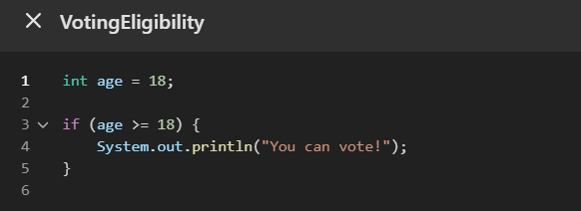
Conditional Statements
if Statement
If block executes only true statement
“If age is 18 or more, then print ‘You can vote!’”
Use it when you want to do something only if a condition is true.
Think: “If this happens, then do this.”

Slide 27
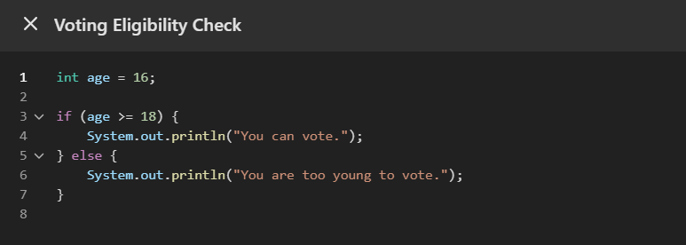
Conditional Statements
if – else Statement
If block executes only true statement
Else block executes false statement
Either one of the two blocks will run.
“If age is 18 or more, print true block; else, print false block.”
Use it when you have two choices — do one thing if true, or something else if false.
Think: “If this happens, do this. Else, do that.”

Slide 28
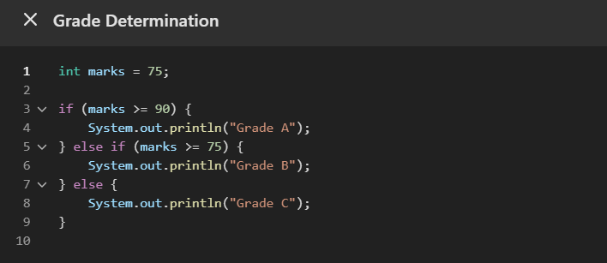
Conditional Statements
Else if ladder
If block executes only true statement
Else block executes false statement
“Check each condition step-by-step. Only one will run.”
Use it when you have many conditions to check one by one.
Think: “If this, do this. Else if that, do that. Else, do something else.”

Slide 29
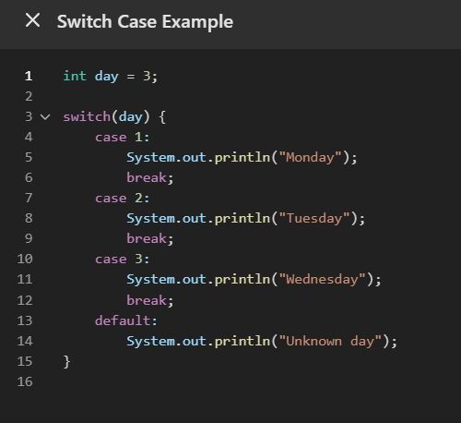
Conditional Statements
Switch Case
Use it when you have one variable and many fixed values to check.
Think: “If it is this case, do that.”
Switch case will take one input and check all cases, if the input does not match to any cases, it will print the default message.

Slide 30
Loops – Repeat Tasks
A loop is used to execute a block of code multiple times based on a condition.
A loop helps you do something again and again automatically in your program until a specific condition is met.
If you want to print "Hello" 5 times without writing the same line 5 times, you use a loop.

Slide 31

For Loop
A for loop runs a set of instructions again and again until a given condition is false.
It is best when the number of repetitions is known.
initialization – starting point (e.g., int i = 1)
condition – the loop continues while this is true (e.g., i <= 5)
update – changes the value in each loop (e.g., i++)

Slide 32
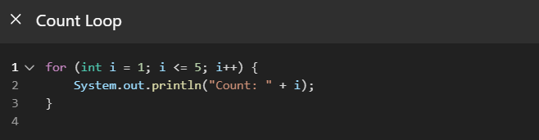
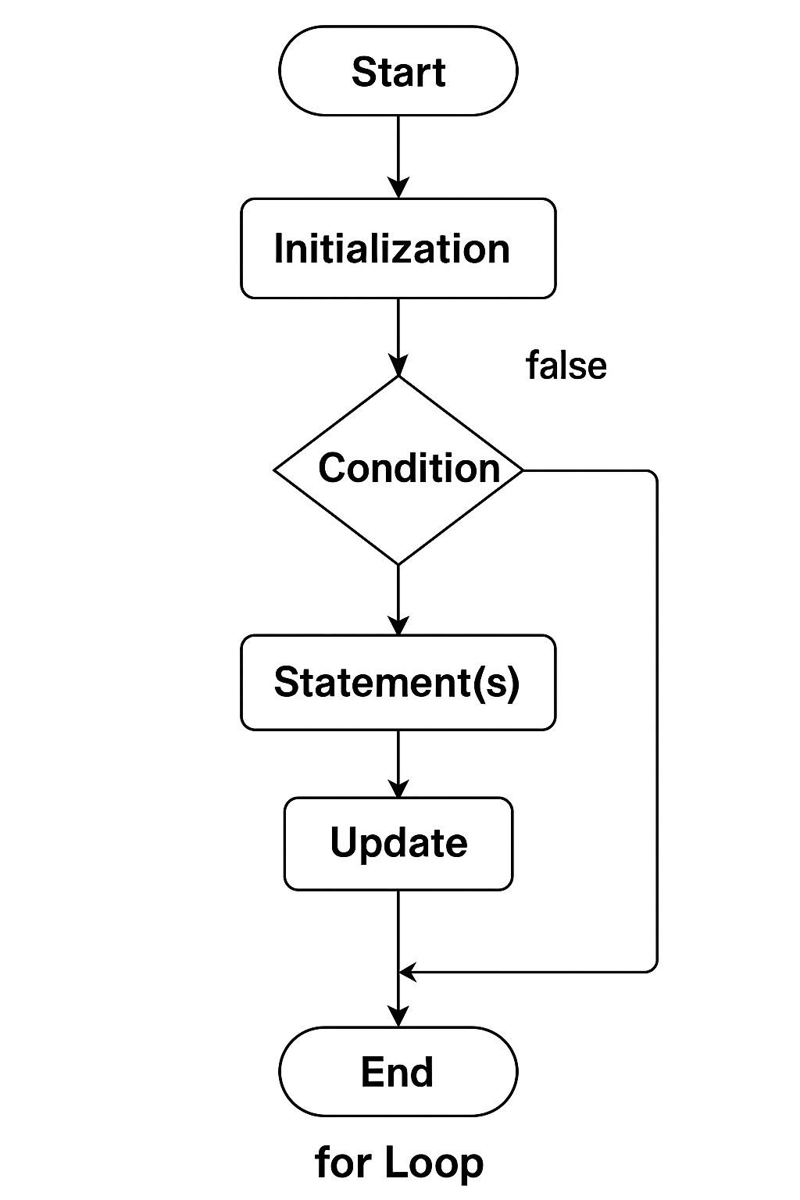
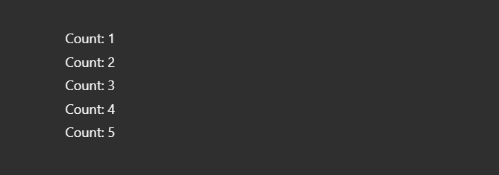
For Loop

Slide 33
While Loop
A while loop in Java is used to repeat a block of code as long as a given condition is true. It checks the condition before each execution, so it might run zero or more times.
It is an entry-controlled loop.
It is used when the condition is important.
If the condition is false at the beginning, the loop won’t run at all.

Slide 34

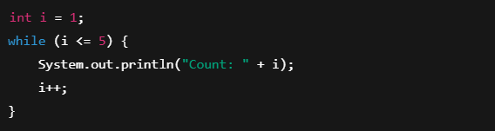
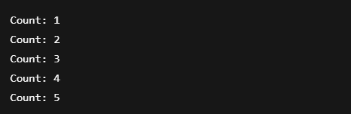
While Loop
Imagine you're filling bottles with water until the tank is empty. You don’t know how many bottles you'll fill — so a while loop fits this case.

Slide 35

do-while Loop
A do-while loop runs the code first, then checks the condition. So, it always runs at least one time, even if the condition is false.
It is an exit-controlled loop.
It is used when the data is important.

Slide 36
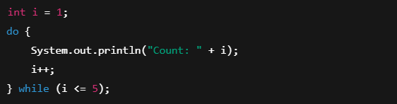
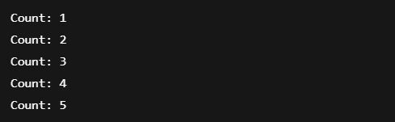
do-while Loop
You try a new dish at least once, and then continue eating only if you like it. Even if you dislike it, you already tried it — just like do-while.

Slide 37
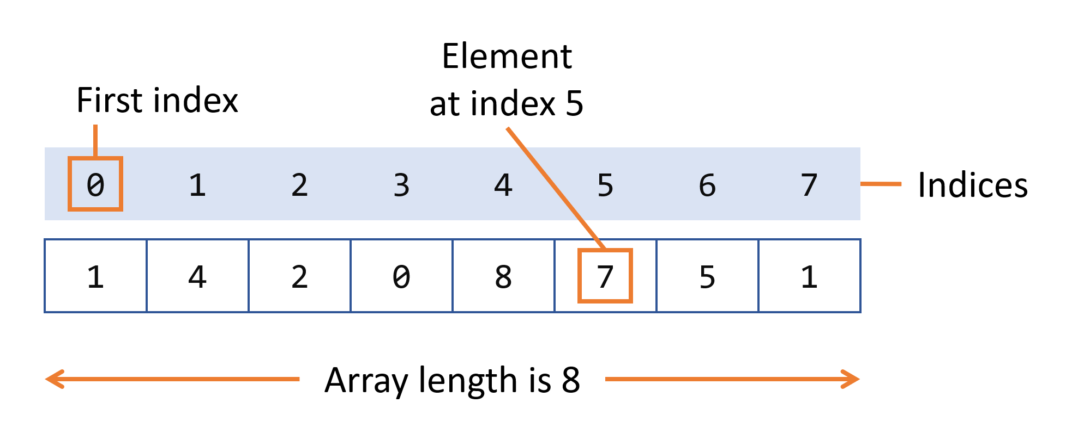
What is an Array in Java?
An array is a collection of similar data items stored at contiguous (side-by-side) memory locations.

Slide 38
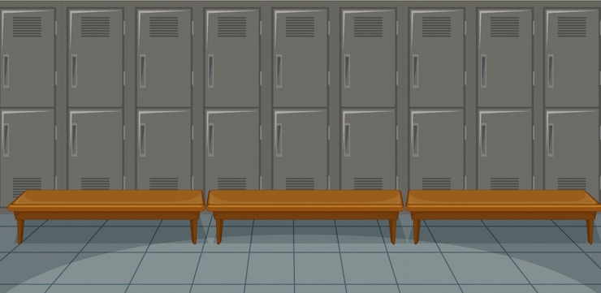
What is an Array in Java?
Think of it like a row of lockers. Each locker (box) holds a value, and you can access it using its number (index).

Slide 39
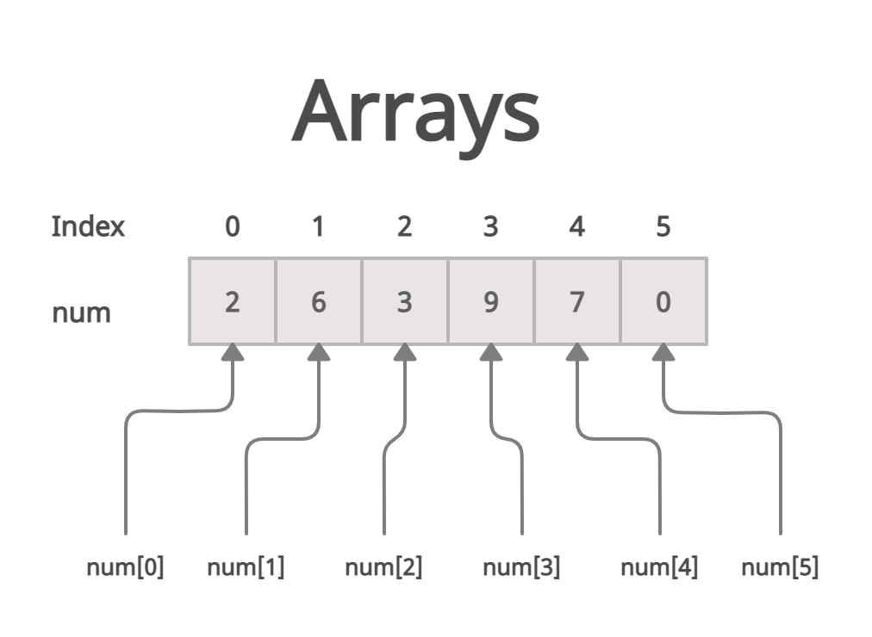


Why Use Arrays?
To store multiple values of the same type (e.g., all integers or all strings)
Instead of writing:
You can just write:
Int num [] = {2,6,3,9,7,0}

Slide 40
Types of Arrays in Java
1D Array – Like a list of items
2D Array – Like a table (rows and columns)

Slide 41
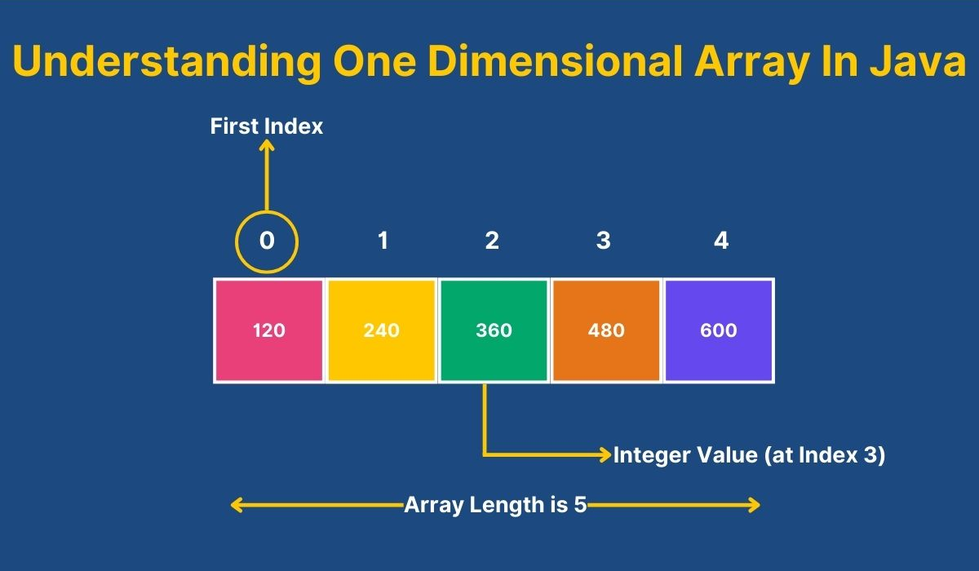
One-Dimensional Array
One of the most commonly used types of arrays is the one-dimensional array. It represents a simple list of elements where each item can be accessed using a single index.

Slide 42
One-Dimensional Array
How to Declare an Array
int[] numbers; // Recommended way
// or
int numbers[];
How to Create an Array
numbers = new int[5]; // Creates array of size 5
How to Initialize an Array
int[] numbers = {10, 20, 30, 40, 50};
Access Elements in an Array
System.out.println(numbers[0]); // Output: 10
Update Elements in an Array
numbers[2] = 100; // Changes the 3rd element to 100
Length of Array
int[] numbers = {10, 20, 30, 40, 50};
System.out.println(numbers.length); // Output: 5
Loop Through an Array
for (int i = 0; i < numbers.length; i++) {
System.out.println(numbers[i]);
}

Slide 43
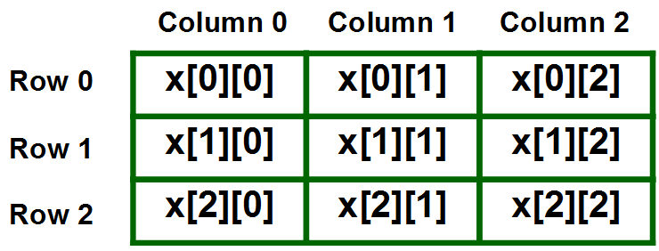
Two-Dimensional Array
A 2D array (two-dimensional array) in Java is like a table or a grid with rows and columns. It's like an array of arrays.
Think of it like a matrix in math:
int[][] numbers = {
{1, 2, 3},
{4, 5, 6},
{7, 8, 9}
};
This is a 3x3 2D array (3 rows and 3 columns).

Slide 44
2D Arrays (Matrix)
Syntax: - int[][] arrayName = new int[rows][columns];
Example - int[][] marks = new int[2][3]; // 2 rows, 3 columns
Access Elements - marks[0][0] = 10; // first row, first column
marks[1][2] = 20; // second row, third column

Slide 45
2D Arrays (Matrix)
Looping through a 2D Array:
for (int i = 0; i < 2; i++) {
for (int j = 0; j < 3; j++) {
System.out.print(marks[i][j] + " ");
}
System.out.println();
}

Slide 46
3x3 Table
J =Column 0
J=Column 1
J=Column 2
1 | 2 | 3
4 | 5 | 6
7 | 8 | 9
I =Row 0
I = Row 1
I = Row 2

Slide 47
What is a Method?
A method is a block of code that performs a specific task.
Think of it like a machine: You give it input → It does something → Gives you output.
Real-life analogy: 🔧 Juicer Machine:
You give fruits (input)
It processes (method logic)
You get juice (output)

Slide 48
Why Use Methods?
Avoid code repetition (DRY principle)
Easy to read and maintain
Divides large problems into smaller pieces
Example: Instead of writing the same code to calculate area in 3 places, write it once in a method and reuse it.

Slide 49
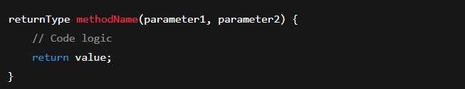
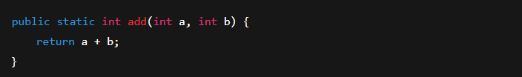
Method Structure / Syntax

Slide 50

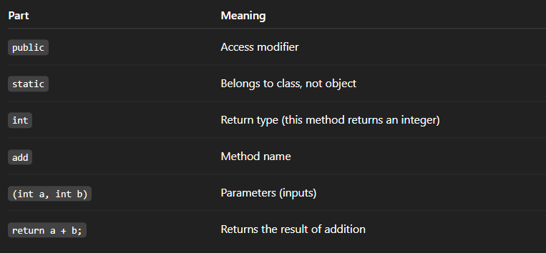
Breaking Down the Example

Slide 51

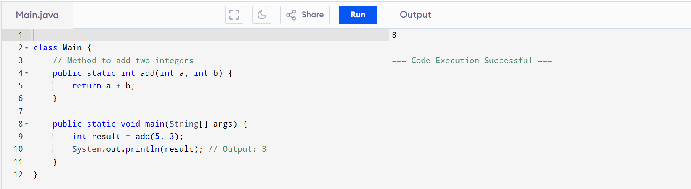
Calling a Method

Slide 52
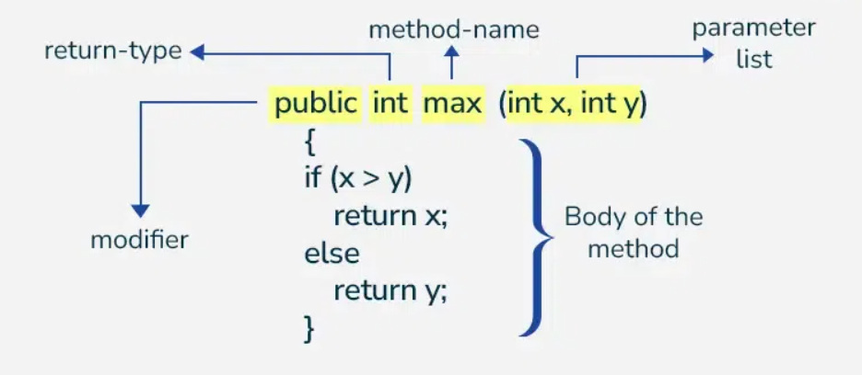
Types of Methods
1. Return Type + With Parameters
2. No Return Type + With Parameters
3. No Return Type + No Parameters
4. Return Type + No Parameters

Slide 53
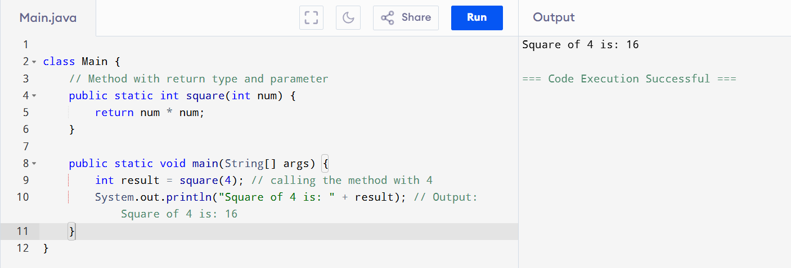
Return Type + With Parameters
Return Type: int (returns an integer)
With Parameters: Takes one parameter int num
square(int num) — takes an integer num and returns num * num.
int result = square(4); — calls the method and stores the result.
System.out.println(...) — prints the result.

Slide 54
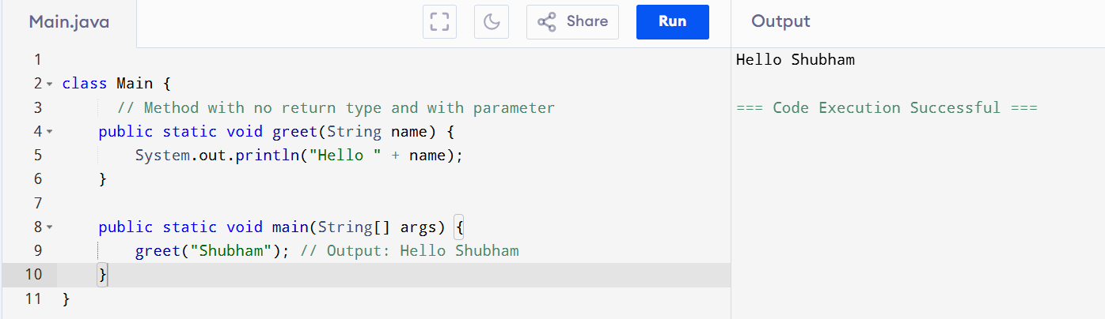
No Return Type + With Parameters
No Return Type: void (doesn’t return anything)
With Parameters: Accepts a parameter String name
void greet(String name) — This method doesn't return anything, just prints a message.
You call it with a name like "Shubham".
Output: Hello Shubham

Slide 55
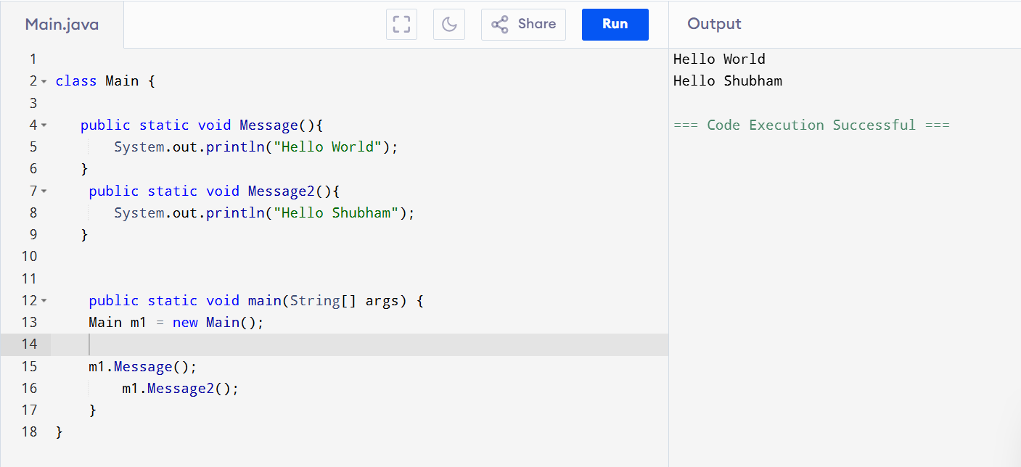
No Return Type + No Parameters

Slide 56
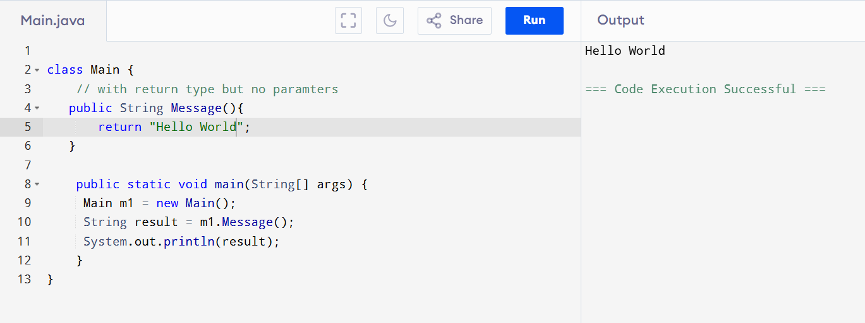
Return Type + No Parameters

Slide 57
Pass by Value in Java
In Java, everything is passed by value, which means:
A copy of the variable’s value is passed to methods, not the original variable itself.
When you pass a variable to a method:
Java creates a copy of the variable.
Any changes made inside the method only affect the copy, not the original variable.
Java is strictly pass by value

Slide 58
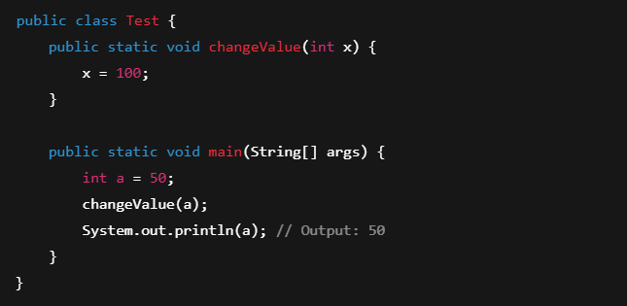
Pass by Value in Java
Imagine you give your photocopy of a document to someone. They can write on it, tear it, or modify it — but your original document remains unchanged.
Why is output still 50? Because x = 100 changes only the copy of a, not the original a.

Slide 59
Complexity
Time Complexity: Time Complexity is how much time an algorithm takes to complete, based on the size of the input.
Space Complexity:Space Complexity is how much extra memory (RAM/space) an algorithm uses while running, based on the input size.

Slide 60
Time Complexity
Time complexity is the amount of time a program or algorithm takes to run, depending on the size of the input.
In simple words: "How long does it take to finish?"

Slide 61
How to Calculate Time Complexity
Step 1: Look at the Input Size
Usually denoted by n. It could be the size of an array, list, number of elements, etc.
Step 2: Count the Number of Operations
Check how many times each part of the code runs.
Step 3: Focus on the Loops and Recursive Calls
Loops and recursion usually dominate time complexity.

Slide 62
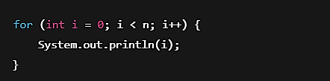
Example 1: Simple Loop
Runs n times
Time Complexity: O(n)

Slide 63
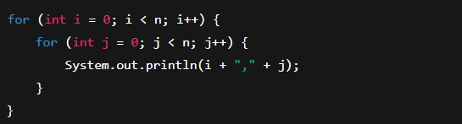
Example 2: Nested Loop
Outer loop → n times
Inner loop → n times for each outer loop
Total operations: n * n
Time Complexity: O(n²)

Slide 64
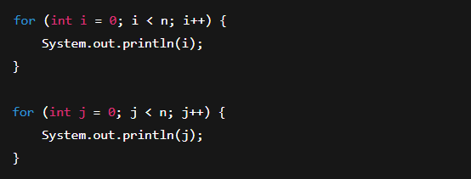
Example 3: Two Separate Loops
First loop → n times
Second loop → n times
Time Complexity: O(n + n) → O(n)

Slide 65
Space Complexity
Space complexity is the amount of memory (RAM or storage) an algorithm uses while running, depending on the input size.
In simple words: "How much extra space does it need?"

Slide 66
How to Calculate Space Complexity
Step 1: Identify All Variables
Count all variables used (including arrays, lists, maps, etc.).
Step 2: Check for Loops & Recursion
Loops don’t usually increase space unless you create new variables inside them.
Recursion adds to call stack memory.
Step 3: Focus on How Variable Size Grows with Input
If variable size increases with input size n, it adds to space complexity.

Slide 67
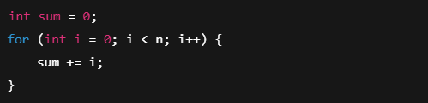
Example 1: No Extra Space
Variables: sum, i → constant space
Space Complexity: O(1) → constant

Slide 68

Example 2: Using an Array
Array of size n → takes linear space
Space Complexity: O(n)

Slide 69

Example 3: Nested Arrays
2D array → total size = n * n
Space Complexity: O(n²)

Slide 70
What is Sorting?
Sorting means arranging elements in a specific order — usually ascending (smallest to largest) or descending (largest to smallest).
Original list: [5, 3, 1, 4, 2]
After sorting in ascending order: [1, 2, 3, 4, 5]

Slide 71
Why is Sorting Important?
Makes data easier to search (especially for Binary Search)
Helps in organizing data (e.g., marks, prices, names)
Used in algorithms, databases, leaderboards, e-commerce filters, etc

Slide 72
Types of Sorting Techniques:
Sorting Method | Description
Bubble Sort | Simple, slow, compares neighbors
Selection Sort | Picks the smallest and places it
Insertion Sort | Builds sorted array one by one
Merge Sort | Uses divide and conquer (fast)
Quick Sort | Divides using pivot (very fast)

Slide 73

Bubble Sort
Bubble Sort repeatedly compares adjacent elements and swaps them if they are in the wrong order.
Biggest numbers “bubble up” to the end in each pass.
Sort this array: [5, 3, 1]
Pass 1:
Compare 5 and 3 → swap → [3, 5, 1]
Compare 5 and 1 → swap → [3, 1, 5]
Pass 2:
Compare 3 and 1 → swap → [1, 3, 5]

